Slide 1

Data Mining
WQD180057 - Amirsaman Ahmadi

Slide 2

Outline
Introduction
Data Acquisition
Web Crawling
Data Preparation
Modelling
Finding and results
Conclusion
Recommendation

Slide 3
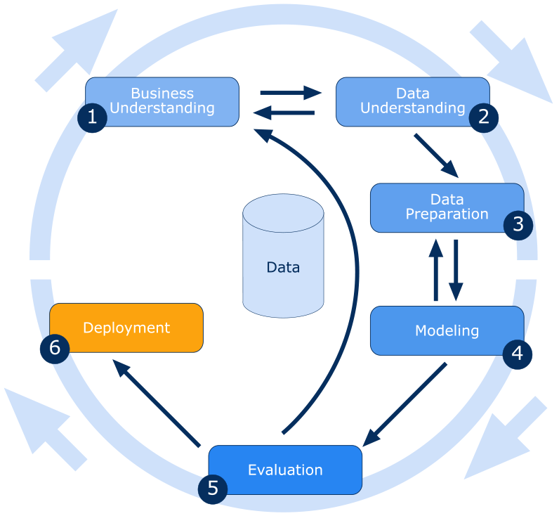
Introduction

Slide 4



Data Acquisition
Stock Data (The Start News)
Oil, Gas, Gold, Silver Data (Investing.com)
News Data (TheEdgeMarkets.com)

Slide 5
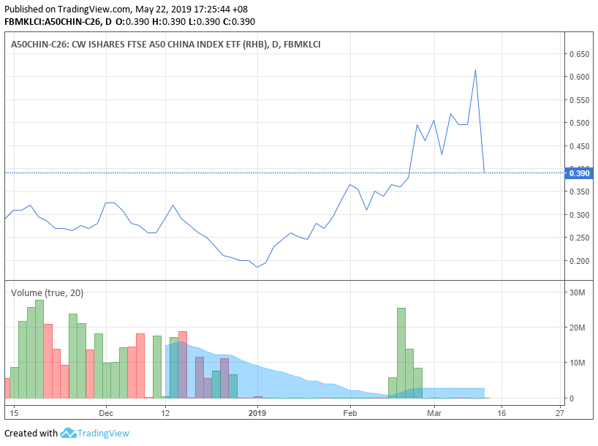
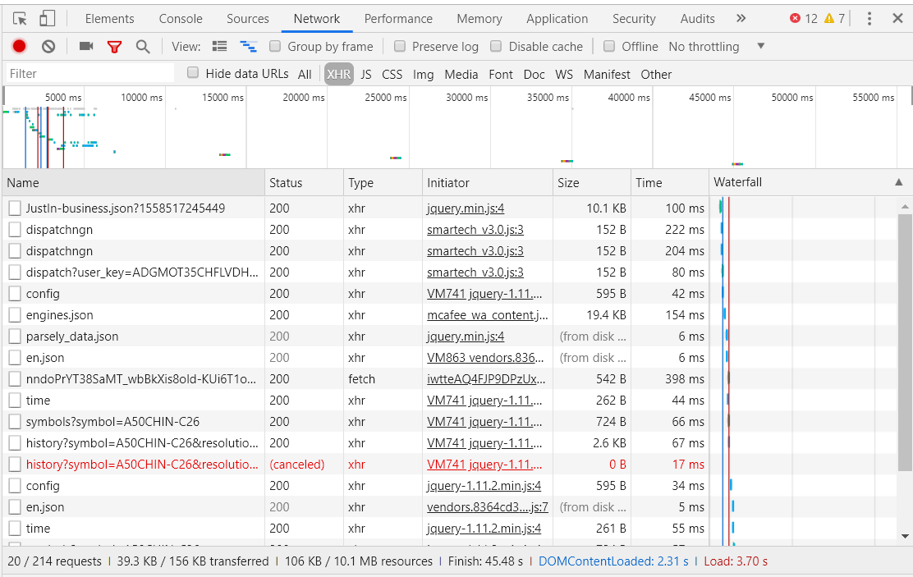
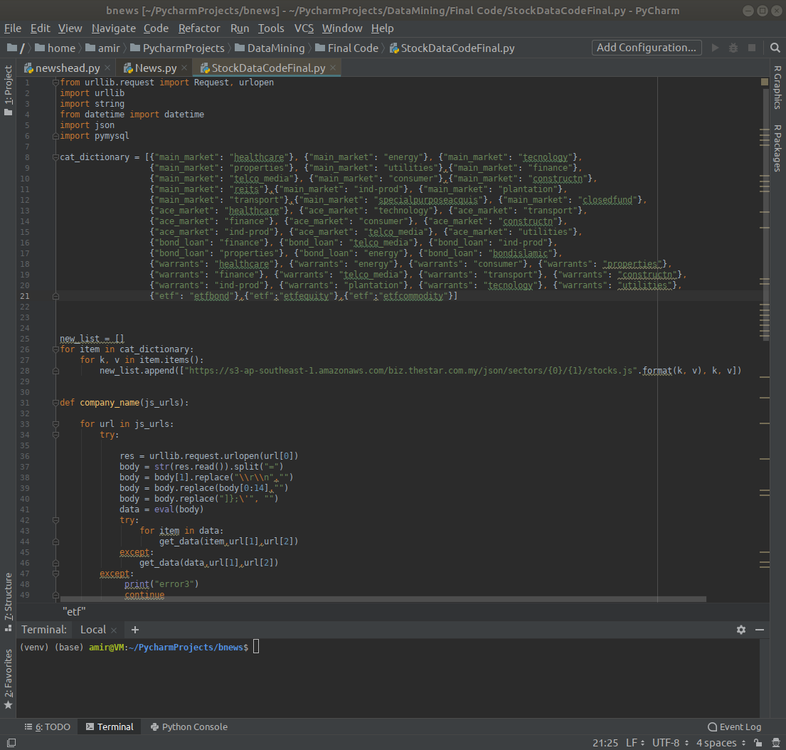
Web Crawling
Json
Timestamp
SQL
HDFS

Slide 6
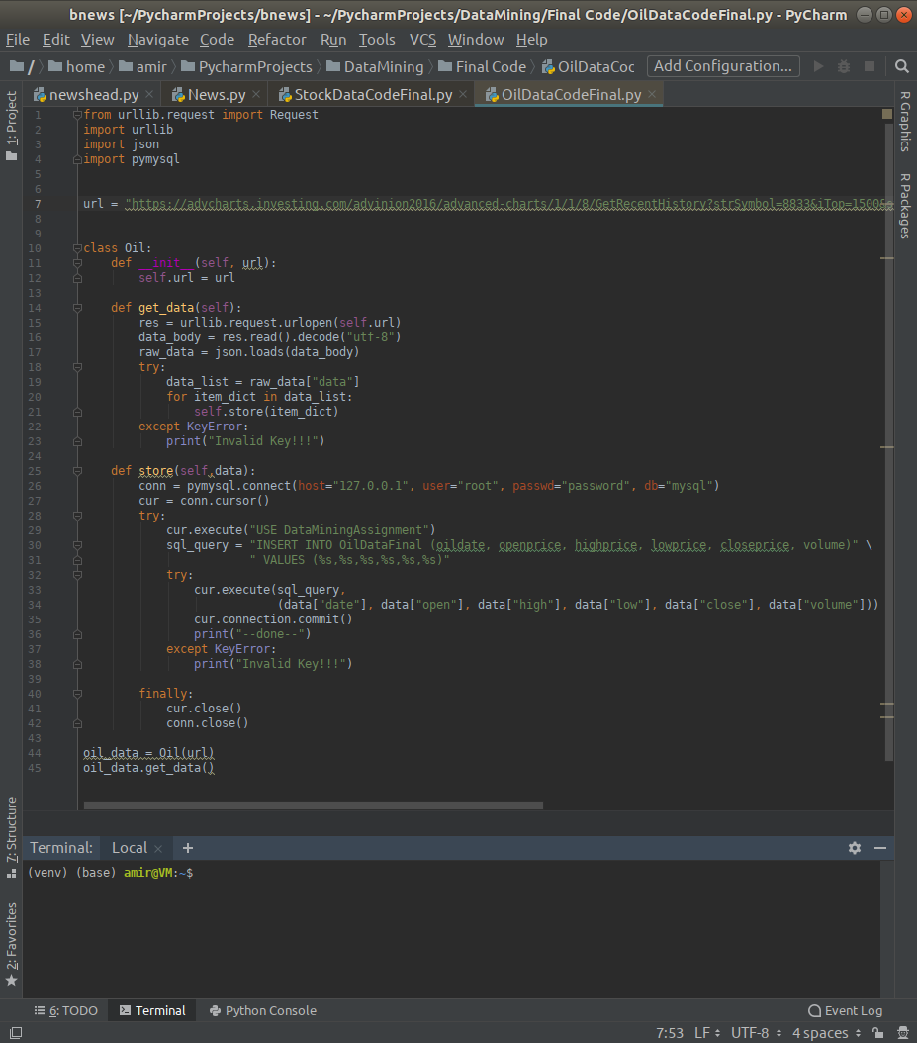
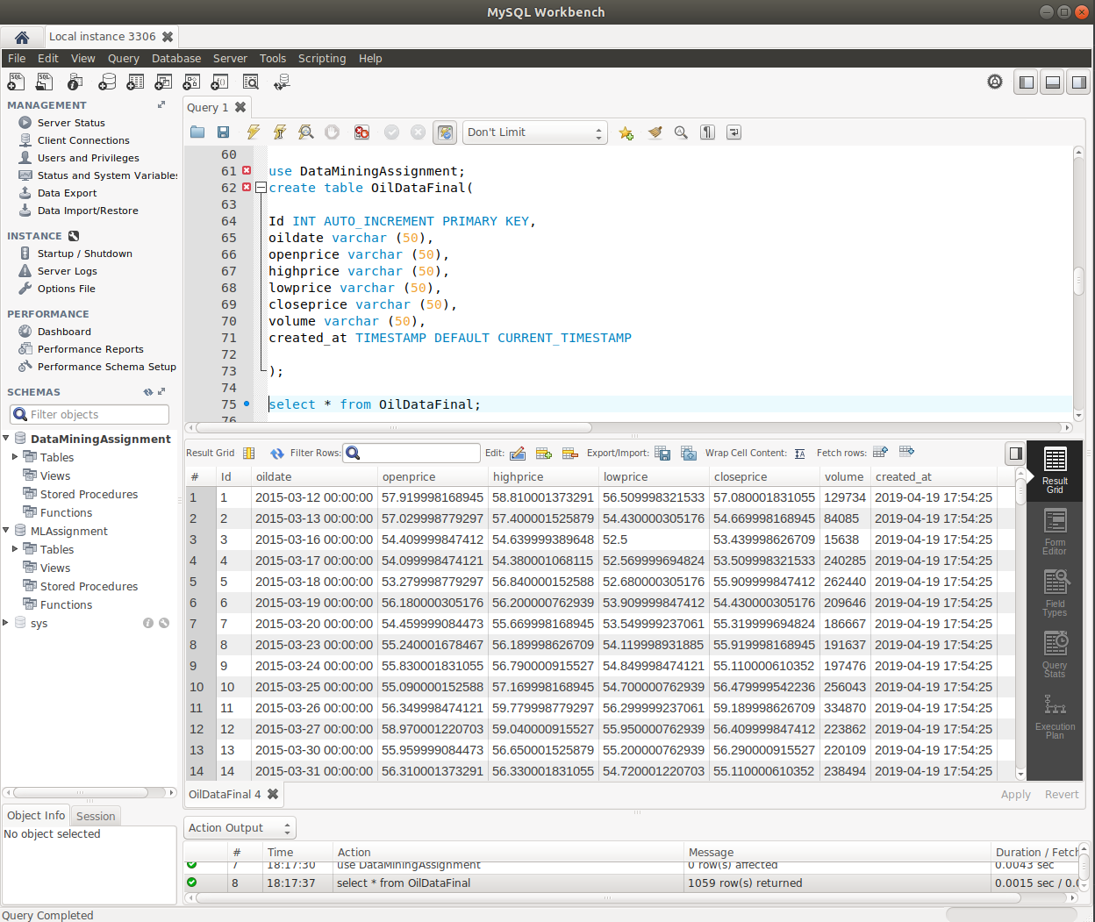
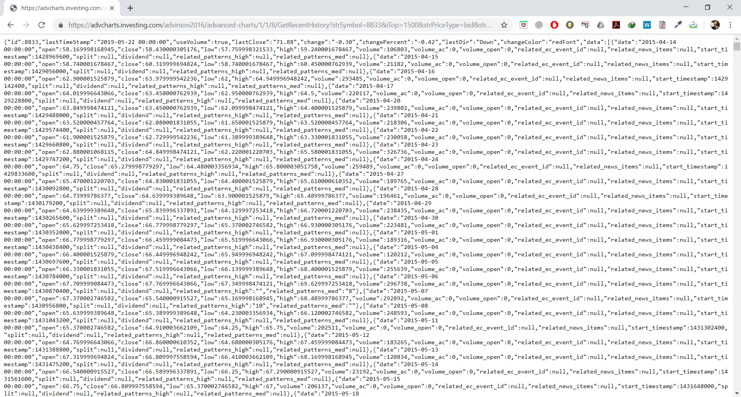
Web Crawling
Json
SQL
HDFS

Slide 7
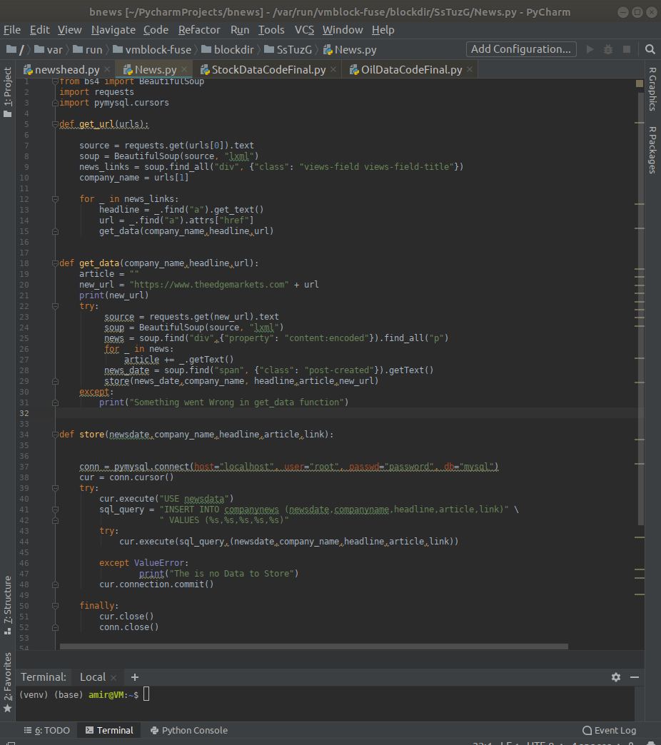
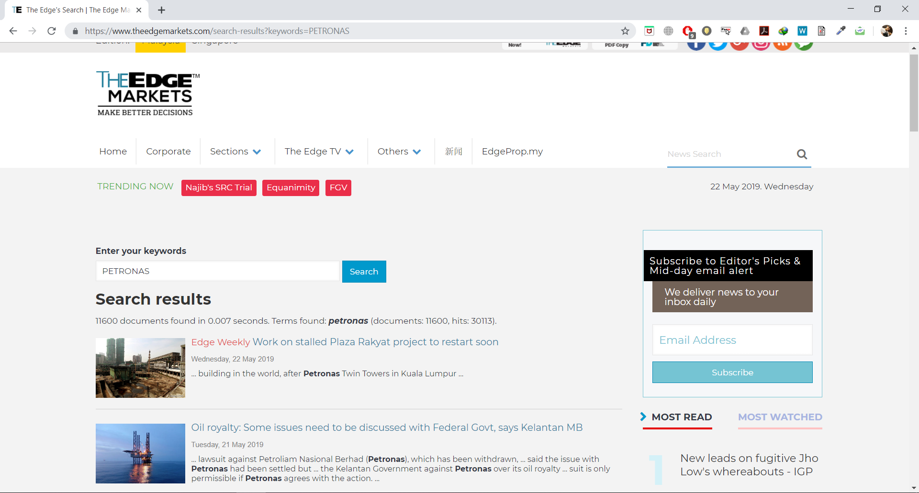
Web Crawling
BeautifulSoup
SQL
HDFS

Slide 8
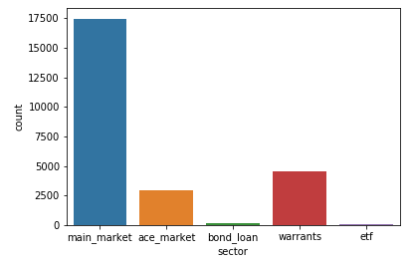
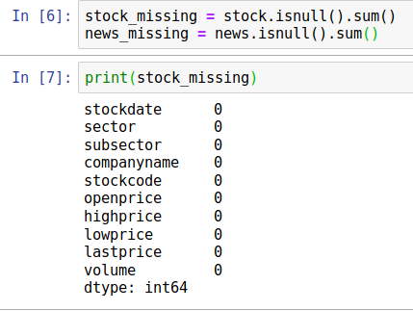
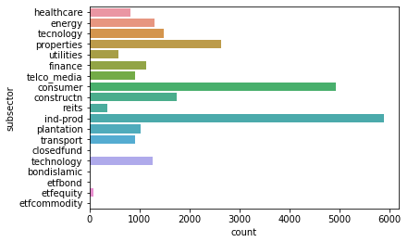
Data Preparation
Missing Values
Finding Outliers
Ambiguous Values
Data Visualization

Slide 9
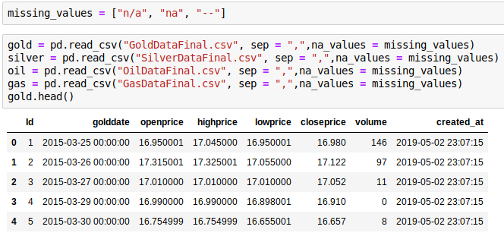
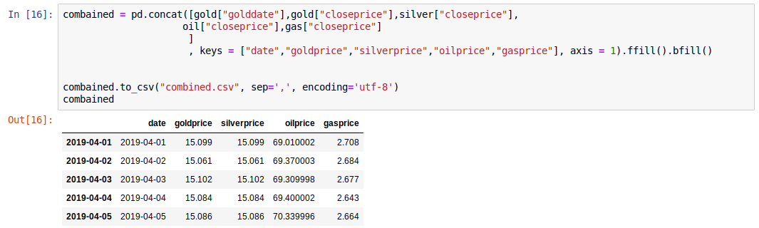
Data Preparation
Ambiguous Values
Data Types
Combining Data

Slide 10
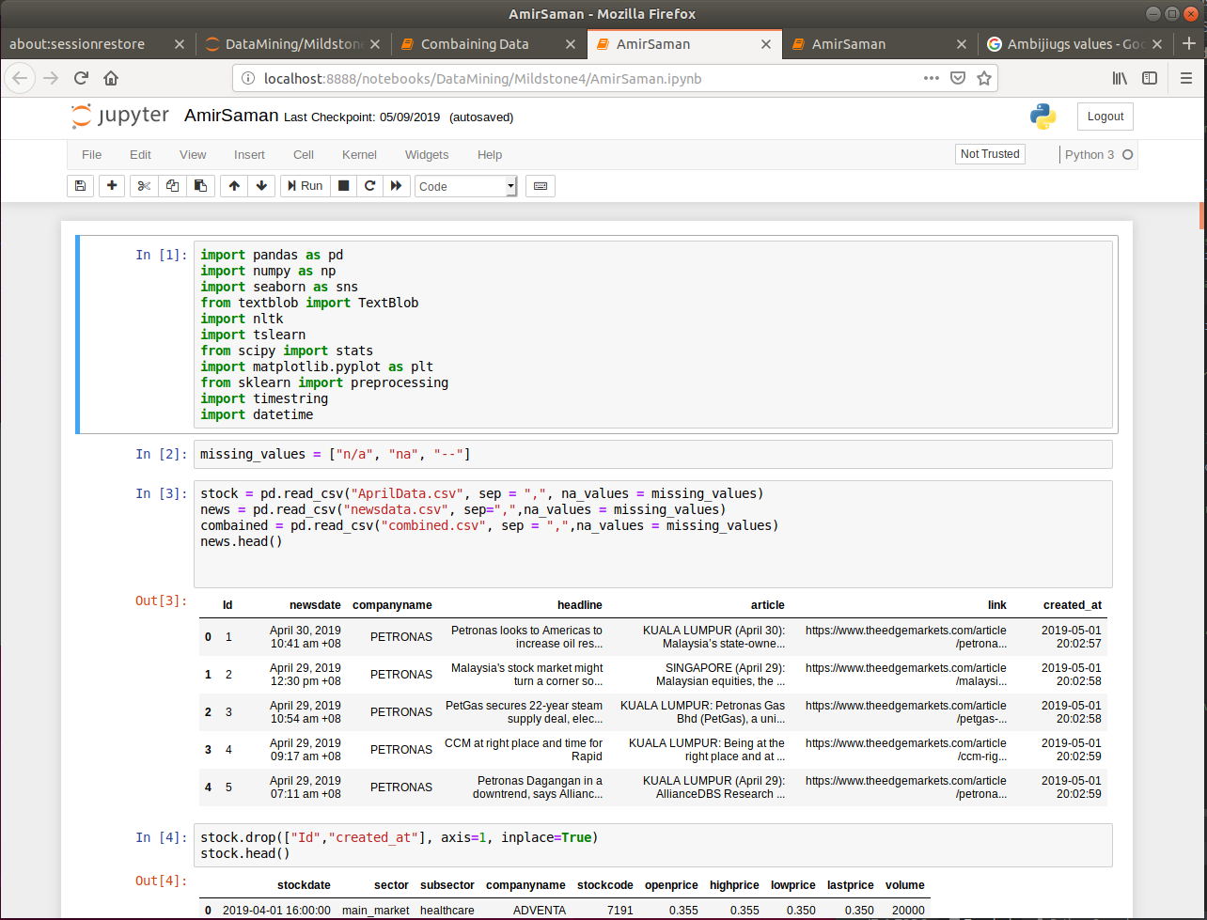
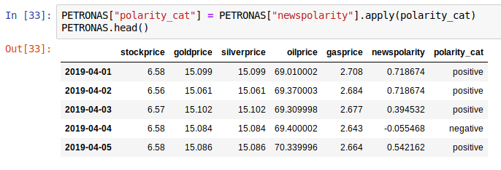
Data Preparation
Text Mining
Correlations & Covariance
Feature Selections
Splitting Data based on The companies
Converting to SAS format

Slide 11
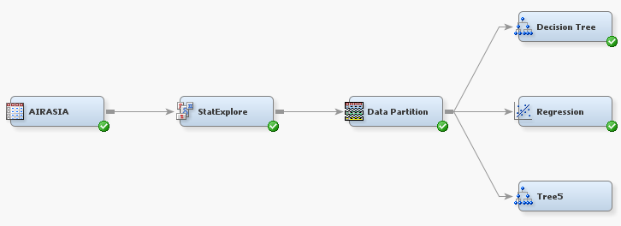
Modelling
Four Companies
SAS Enterprise Miner
Decision Tree
Regression
Data Partition (70%/30%)

Slide 12
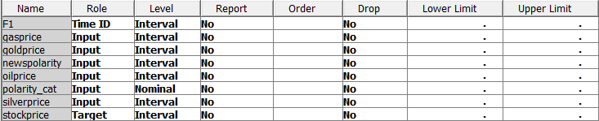
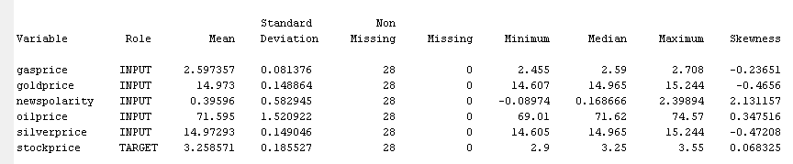
Modelling
Summary Of the Models

Slide 13
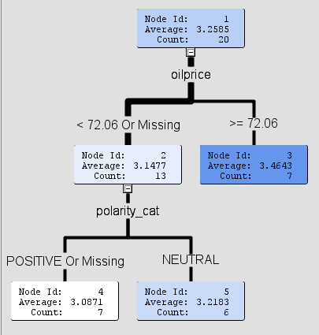
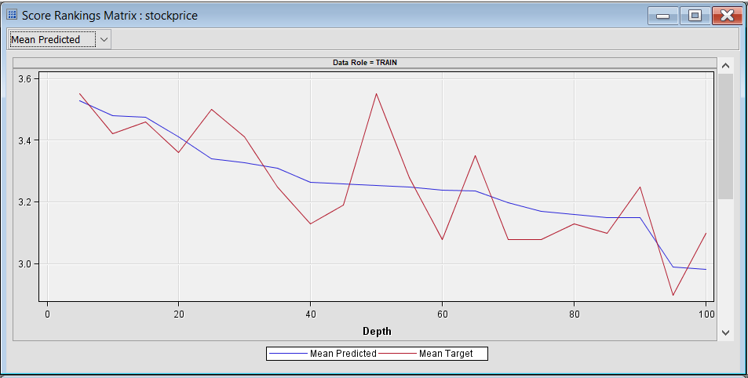
Findings & Results
 | Correlation | Information Gain
Oil Price | 0.67167 | 4.9243
Gas Price | -0.40106 | 1.2887
Gold Price | -0.37718 | 1.2887
Silver Price | -0.37712 | 1.2569
News Polarity | 0.29177 | 0.3347

Slide 14
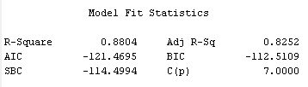
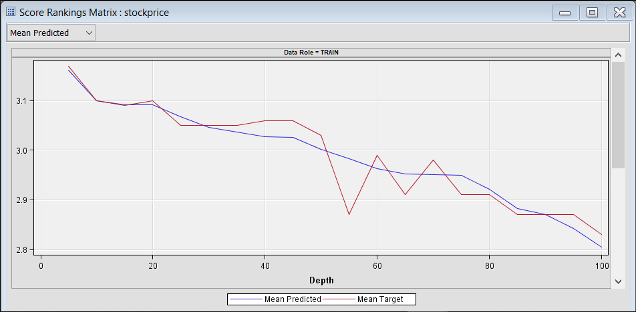
Findings & Results
 | Correlation | Information Gain
Oil Price | -0.85034 | 6.7363
Gas Price | 0.78559 | 4.4425
Gold Price | 0.57396 | 2.7724
Silver Price | 0.57368 | 2.7724
News Polarity | 0.28445 | 0.1066

Slide 15
Conclusion
GAMUDA, PETRONAS and AirAsia are fairly correlated with the selected features however further data and modelling is required in order to enhance the accuracy.
Gold and Silver have direct relationship.
Telekom Malaysia (TM) Stocks is highly related to oil price.

Slide 16
Recommendation
Telekom Malaysia stock holders can apply suggested model in their daily life since it has 88% accuracy to maximize their return on their investment.
Source code of this project can be accessed here

Slide 17
Q&A

Slide 18
Thank you

